Slide 1




Data-driven Proficiency Profiling
Behrooz Mostafavi
Zhongxiu “Aurora” Liu
Tiffany Barnes
Notes:
Hi, I’m zhongxiu aurora liu. Today I’m present a paper data-driven proficiency profiling. The first author is Behrooz Mostafavi, and our advisor is Dr. Tiffany Barnes

Slide 2
Introduction of Deep Thought
Current Method: DDML
New Method: DDPP
Evaluation
Result
Notes:
First I will introduce the system where we apply the proficiency profiling. Deep Thought

Slide 3
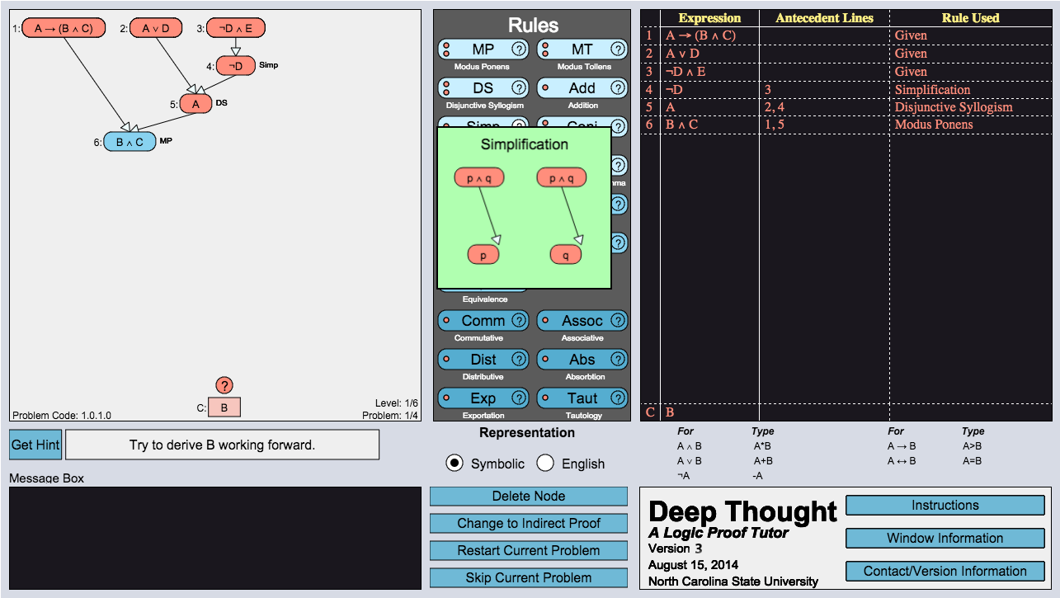
Deep Thought
Behrooz Mostafavi
bzmostaf@ncsu.edu
Notes:
Deep thought is a logic tutor. As opposed to traditional list-based format of proof solving, student use graphical representation- start from premises to derive new statements, build up the tree, until they reach the conclusion.
(Croy 2000 argues that students should be taught to move forward and backward, graph presentation gives the flexibility)
My collegue Behrooz Mostafavi created and maintains deep thought. Deep thought is applied in college classrooms, and behrooz has collected years of data of deep thought. So definitely contact him if you are interested
The advantage of using Deep Thought to practice solving logic proofs is the graphical representation, showing students how all the expressions are related to each other (convergence) combined with individual logical operations (rules)
As opposed to the traditional list-based format of proof solving (at the right0
Additionally, because Deep Thought is an intelligent and adaptive system, the selection of WHICH proof problems provides for better scaffolding of domain concepts (Mastery learning)
“The Behavior of Tutoring Systems” Kurt VanLehn (2006) he describes mastery learning (inner and outer loop)
Outer loop: level based systems “leveling up”
Inner loop: DDML/proficiency calculations

Slide 4
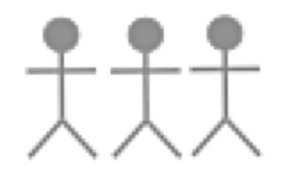
Proficiency in Deep Thought
High Proficiency Track
Perform
Assessments on KC scores
Assessments on KC scores
Perform
Perform
Level 1
Low Proficiency Track
Level 2
Level 3
Notes:
Next, I’m going to introduce the concept of proficiency in deep thought. Deep thought has the intelligent feature of assigning students to different proficiency tracks based on their KC scores. High track contains more difficult problem then the low track.
At start level, all students perform many problems of prove; after completing the level, students’ KC (rule) scores are assessed, and students are assigned to different tracks for level 2. While in level 2, some students may be slided down from high track to low track if they skipped certain number of problems. The skipped student is considered as “wrongly classified”. Then we do assessment on all students data on level 2, and assign different tracks for level 3 problems.

Slide 5
Introduction of Deep Thought
Current Method: DDML
Data driven mastery learning
New Method: DDPP
Evaluation
Result
Notes:
Now, we’ll move towards the current method of assigning proficiency tracks. Called data-driven master learning

Slide 6
DDML
DDML increases completion rate and decreases drop-out rates (Mostafavi, Eagle, Barnes 2015)
For a level:
KC1 | KC2 | KC3
0.3 | 0.8 | 0.5
Student’s KC scores
Notes:
Previous research by Mostafavi, Eagle and Barnes have shown that DDML tack-assignment increases completion rate and decreases drop-out. Here’s an example to explain DDML, for level I, we calculated students KC scores as shown in the slide
Simple example of student KC score -> expert decide 1 0 -1 (for each level) -> example calculated score (compare with min) -> assign path; circle on expert decided and calculated score
Each KC score (at the end of each level) is compared to threshold scores for that particular level. [Threshold score is an average of exemplar scores from previous DT use for each KC]
The difference of KC and Threshold scores (will be + or -) is weighted by the PRIORITY for that particular KC(rule). Priority is either 0 (that rule was not important for this level) or 0.5 (that rule was necessary to solve proofs, but was not the focus of that particular level) or 1 (that rule was the focus of that particular level).
All the weighted differences are summed. If the sum is > 0, high path, if the sum is < 0, low path.
Refer to LAK 15 short paper “Towards data-driven mastery learning” to explain this

Slide 7
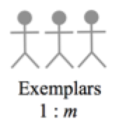
DDML
KC1 | KC2 | KC3
0.3 | 0.8 | 0.5
KC1 | KC2 | KC3
0.5 | 0.5 | 0.5
--
Student’s KC scores
Avg KC scores of students who completed the level
Notes:
We than compare this student scores to avg score of past students who completed the level.
Simple example of student KC score -> expert decide 1 0 -1 (for each level) -> example calculated score (compare with min) -> assign path; circle on expert decided and calculated score
Each KC score (at the end of each level) is compared to threshold scores for that particular level. [Threshold score is an average of exemplar scores from previous DT use for each KC]
The difference of KC and Threshold scores (will be + or -) is weighted by the PRIORITY for that particular KC(rule). Priority is either 0 (that rule was not important for this level) or 0.5 (that rule was necessary to solve proofs, but was not the focus of that particular level) or 1 (that rule was the focus of that particular level).
All the weighted differences are summed. If the sum is > 0, high path, if the sum is < 0, low path.
Refer to LAK 15 short paper “Towards data-driven mastery learning” to explain this

Slide 8
DDML
KC1 | KC2 | KC3
0.3 | 0.8 | 0.5
KC1 | KC2 | KC3
0.5 | 0.5 | 0.5
--
Student’s KC scores
Avg KC scores of students who completed
X
Expert determined KC weight
KC1 | KC2 | KC3
1 | 0.5 | 0
Focus & necessary | 1
Necessary, not focus | 0.5
Not necessary, not focus | 0
Weight interpretation
Notes:
Next, we multiply the different between student’s score and avg score with expert detemined KC weight. Here, weight has three values: 1 means the rule is ……..
Simple example of student KC score -> expert decide 1 0 -1 (for each level) -> example calculated score (compare with min) -> assign path; circle on expert decided and calculated score
Each KC score (at the end of each level) is compared to threshold scores for that particular level. [Threshold score is an average of exemplar scores from previous DT use for each KC]
The difference of KC and Threshold scores (will be + or -) is weighted by the PRIORITY for that particular KC(rule). Priority is either 0 (that rule was not important for this level) or 0.5 (that rule was necessary to solve proofs, but was not the focus of that particular level) or 1 (that rule was the focus of that particular level).
All the weighted differences are summed. If the sum is > 0, high path, if the sum is < 0, low path.
Refer to LAK 15 short paper “Towards data-driven mastery learning” to explain this

Slide 9
DDML
KC1 | KC2 | KC3
0.3 | 0.8 | 0.5
KC1 | KC2 | KC3
0.5 | 0.5 | 0.5
--
Student’s KC scores
Avg KC scores of students who completed
X
(0.3-0.5)*1+
(0.8-0.5)*0.5+
(0.5-0.5)*0 = -0.05
< 0 low proficiency path
> 0 high proficiency path
Expert determined KC weight
KC1 | KC2 | KC3
1 | 0.5 | 0
Assign Path
Focus & necessary | 1
Necessary, not focus | 0.5
Not necessary, not focus | 0
Weight interpretation
Notes:
So the result is now shown here. For kc1, student get 0.3 minus avg 0.5, multiply by the expert assigned weight 1. sum all rule together, we got -0.05. because its smaller than 0, the student is assigned to low proficiency path
Simple example of student KC score -> expert decide 1 0 -1 (for each level) -> example calculated score (compare with min) -> assign path; circle on expert decided and calculated score
Here DDML has two flaws. First, comparing with average ignore the fact that students will focus on different rules (kc) to derive a conclusion, or in other words, different problem solving strategies. Second, kc weights are determined by export, which not only takes effort, but is also constrined by experts background
Each KC score (at the end of each level) is compared to threshold scores for that particular level. [Threshold score is an average of exemplar scores from previous DT use for each KC]
The difference of KC and Threshold scores (will be + or -) is weighted by the PRIORITY for that particular KC(rule). Priority is either 0 (that rule was not important for this level) or 0.5 (that rule was necessary to solve proofs, but was not the focus of that particular level) or 1 (that rule was the focus of that particular level).
All the weighted differences are summed. If the sum is > 0, high path, if the sum is < 0, low path.
Refer to LAK 15 short paper “Towards data-driven mastery learning” to explain this

Slide 10
Introduction of Deep Thought
Current Method: DDML
New Method: DDPP (fully data-driven)
Data driven proficiency profiling
Evaluation
Result
Notes:
Now we move to the new method, data-driven proficiency profiler

Slide 11
Inspiration
Trends in data-driven tutoring (Ritter et al. 2007, Koedinger et al. 2013)
Reduce human design effort and bias
Potentially improve accuracy and interpretation (Elmadani et al 2012, Gonzalez-Brenes & Mostow 2013, Fancsali 2014)
Cluster-based classification
Detects unexpected learning strategies (Kizilcec et al. 2013)
Personalize learning experience (Despotovic-Zrakic et al. 2012, Klasnja-Milicevic et al. 2011)
Notes:
The inspiration of the DDPP is the trend of data-driven tutoring and clustered classification. Data-driven tutoring reduce human design effort and bias.
Also, cluster-base classification. Cluster-based classification is able to detect different learning strategies, some of which may not be expected by human. It will also help to detect students group and personalize learning experience

Slide 12
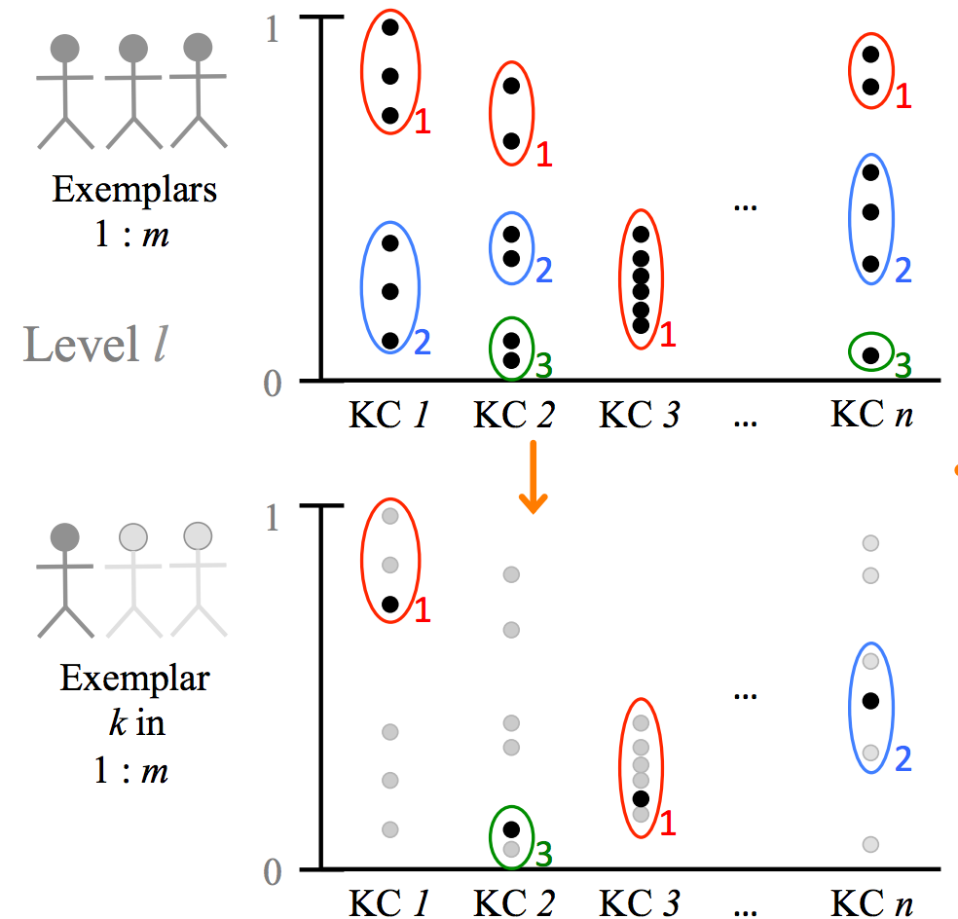
DDPP
S1 - training: clustering (instead of comparing with avg)
Proficiency Profile
Notes:
Step 1 for the raining of DDPP is shown in this slide. Instead of comparing with average, students will be clustered for each KC. Each student will have a profile of the proficiency clusters he/she belongs to for all KCs. we want to see how students score distribute in each KC, and identify their strategy of choosing rules to apply. we want to classify student with clustered based classification

Slide 13
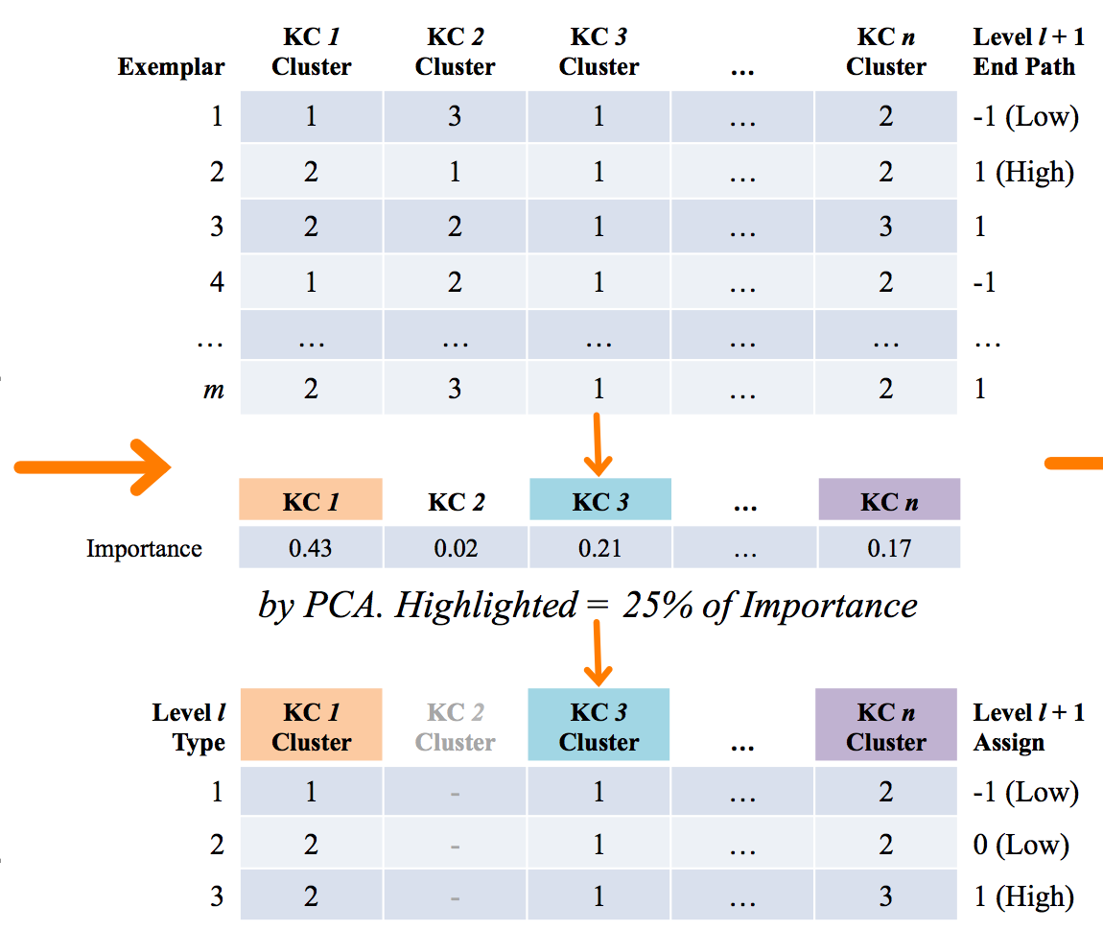
DDPP
S2 - training: Principal Component Analysis (instead of expert determined weight)
Notes:
Here is a proficiency profile for m students. With these data, we applied principal component analysis to choose only KCs by 25% of importance. In this example, we select…..

Slide 14
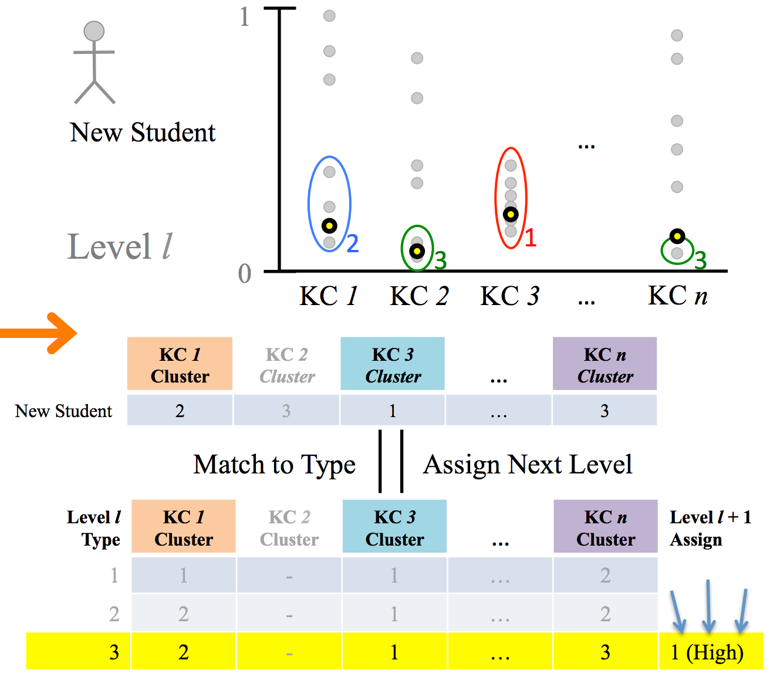
DDPP
Testing:
For new student A
If matched a proficiency profile in history data, same path as in history data
if not, compare with the average
Notes:
In the testing step, when a new student comes, if his/her proficiency profile matches a proficiency profile in a history data, he/she will be assigned to the same path. Otherwise, he/she will be assigned to high/low path through comparing with the average score of all students on the PCA selected KC.

Slide 15
Advantages of DDPP
Weighting logic rules with students’ data, not expert assumptions
Looking for different problem solving strategies that experts would not necessarily be aware of (classroom-specific context)
Notes:
This DDPP has several advantages. First, if weight rules with students history data, not expert, so its completely data-driven. Second, through clustering classification, its looks for different problem solving strategies (what rules students apply to certain , some of which may be missed by experts.
DDML based on studetns who completed levels (ddpp too??? questions)
Explain different student strategies: students who deviate wildly from expert decided strategies will not benefit from expert decisions in evaluation. By using only the data from students who have entered the system, the DDPP will allow students to be evaluated compared to students who solve problems in the same manner

Slide 16
Introduction of Deep Thought
Current Method: DDML
New Method: DDPP
Evaluation
Result
Notes:
Now we are clear about DDML and DDPP, lets see the evaluation and result

Slide 17
Evaluation
Data
47 students from Philosophy deductive logic course (55% complete), NC Charlotte University
84 students from CS Discrete Math course (60% complete), NC State University
Assignments from 2 weeks, 5 levels of problems
10-fold cross validation
Notes:
The data is from college class. …. Total 76. 2 weeks assignment for 5 levels of problems. We conduct 10-fold cross validation for testing

Slide 18
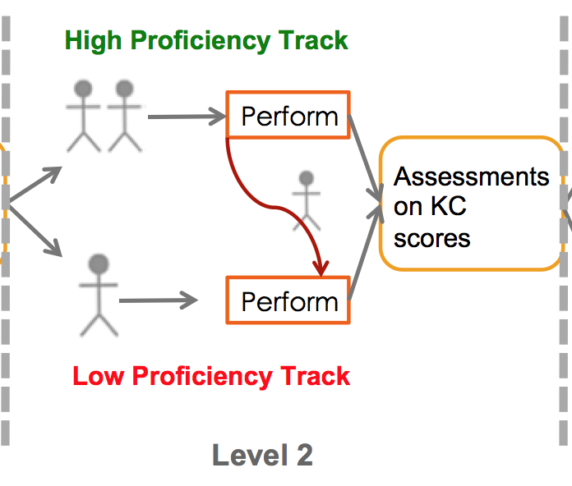
Evaluation
Accuracy:
1- student drops below the assigned path
total student
Notes:
The accuracy, is determined by ……….. As we mentioned before, students skipped certain numbers of problem will be dropped from high path to low path, and ends up in different path.. This means we assign them wrongly

Slide 19
Evaluation
 | Individual Proficiency Score is Compared with | KC Weight
DDPP | Proficiency Profile | PCA
Baseline I - Min | min students KC | PCA
Baseline II- Avg | Average students KC | PCA
Baseline III – Original (DDML) | Average students KC | Expert-determined
Notes:
We compare DDPP with 3 baselines. Min: instead of compared with profile of clusters, we compare KC with minimum score. This is based on the assumption that a high proficiency student should perform at least as good as min. Similarly, for the second baseline, we compare it with average. Finally, for the third baseline we compare with DDML. Notice DDML also compare with average, but its KC weight is expert-detemined, instead of PCA.
explain the different between Avg + DDPP and DDML
Make sure to explain that the minimum and average refers to the threshold scores (original is what was in the system [expert weighting], minimum was the minimum of each kc score [pca weight], average was average, like original, but with pca weighting)

Slide 20
Introduction of Deep Thought
Current Method: DDML
New Method: DDPP
Evaluation
Result
Notes:
Now we are clear about DDML and DDPP, lets see the evaluation and result

Slide 21
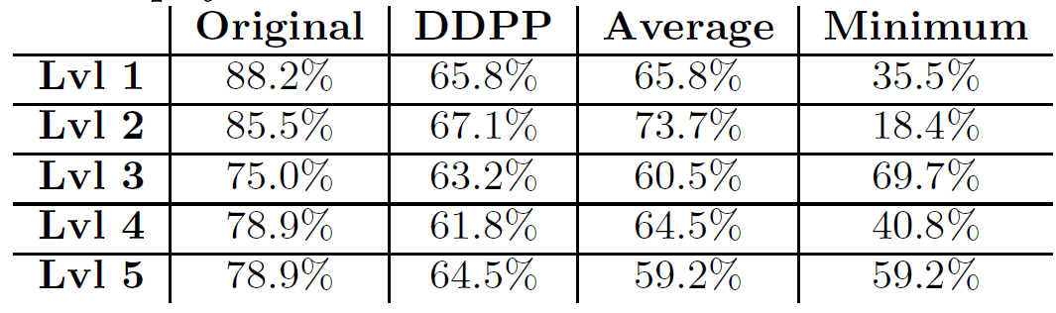
Result I
DDPP vs. Baselines
Notes:
The first result is DDPP with the baselines.

Slide 22
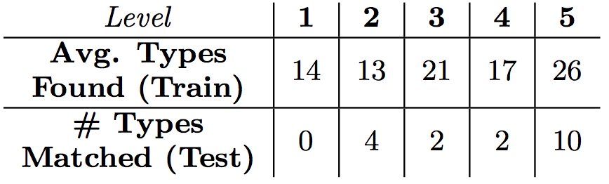
Result I
Origin (DDML) > DDPP=Average > Min
DDPP not the best, but is completely data-driven
Why? hard to match test case to proficiency profile
- not enough students represent all strategies.
Notes:
As you can see, Original is better than DDPP, which is similar to Average and is bigger than min. DDPP is not the best, but we are still happy with the result because it is completely data-driven. An interpretation is that there’s not enough students to represent all student strategy. The table shows number of proficiency profile types for each level in test set. Only a small set of proficiency profile type is matched in test set

Slide 23
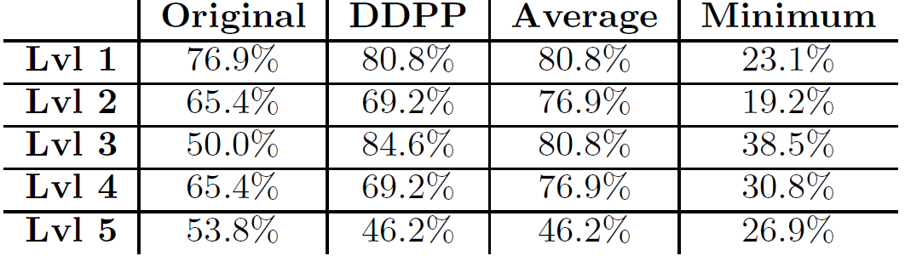
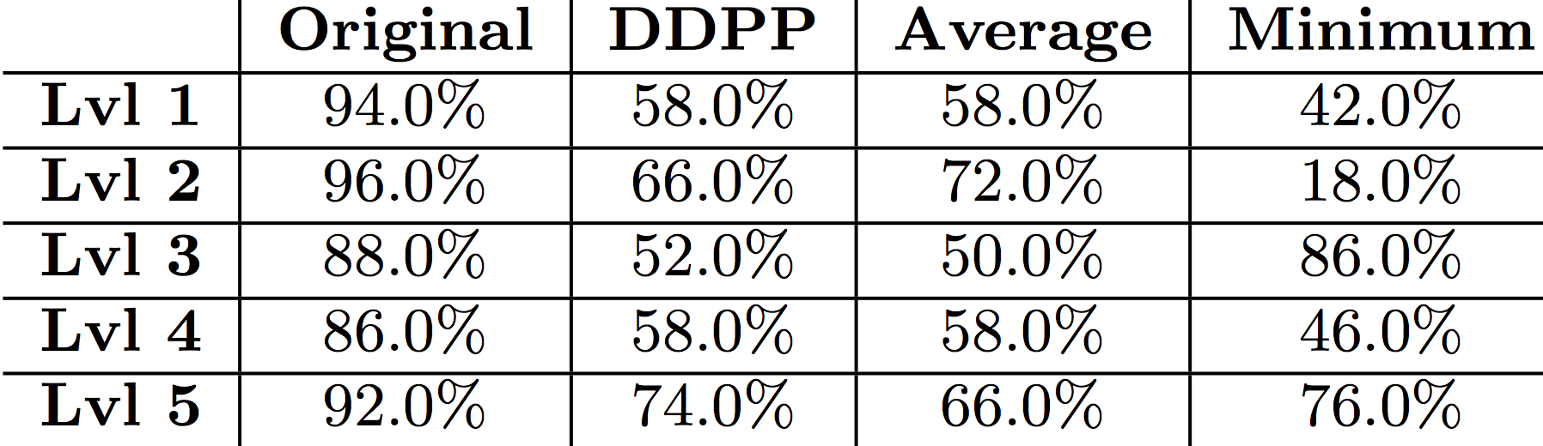
Result II
Philosophy students vs. Computer Science students
Philosophy: DDPP>DDML level 1-4
CS: DDPP<DDML all levels
Notes:
The second result is comparison between philosophy class and computer scienc class

Slide 24
Result II
Philosophy: DDPP=Avg>DDML(Original) level 1-4
Computer Science: DDPP=Avg<DDML(Origin) all levels
Interpretation:
Experts are CS students and teachers
Expert involvement is constrained by expert background.
Data-driven is more flexible for diverse participants
Notes:
From the result, ……….we think this is because our ‘experts’ are CS students and teachers. Their thinking is constrained by strategies solved in CS classes, so their determined weights works better in CS class. Whereas in philosophy class the experts is not aware of how philosophy students’ strategies. So we conclude that data-driven method is more flexible for diverse participants.
This is important in the context of this particular tutor, because the entire point is for students to traverse all the concepts displayed in the tutor in the first place. The more likely a student is guided based on their particular learning style, the more likely they are to complete the ENTIRE tutor, and therefore be exposed to domain concepts required for the course at hand.
This is important for complex problem-solving domains, where many different strategies for solving singular problems would be acceptable (like logic proofs) [there is no one “right answer”]

Slide 25
Conclusion & Future work
Presented: Fully data-driven student proficiency calculator that has potential and limitations
Future goal: fully implement it in Deep Thought
More and more diverse data -> more complete proficiency profiles -> more robust evaluation of the system
Student types. Why do they exist? Learning?
Role of specific logic rules?
Notes:
Conclustion. Here we present a fully data-driven student proficiency calculator that has potential and limitation.
Future goal includes implement this method fully in Deep Thought, so we can apply in real classroom. Our result shows we need more and more diverse data to summarize all strategies and more robustly evaluate the system.
Other questions we want to focus on are : students types. How can proficiency profile to be generalized to student types, why these user type exists and how does it reflect about learning. Also, what could be the role of some specific logic rules?

Slide 26



Thank you!
Questions?
bzmostaf@ncsu.edu
zliu24@ncsu.edu
tmbarnes@ncsu.edu

